Slide 1
Playing Atari with Deep Reinforcement Learning
AUTHORS: V. Mnih, K. Kavukcuoglu, D. Silver, A. Graves,
I. Antonoglou, D. Wierstra, M. Riedmiller
Presenter: Baran kaya

Slide 2
summary
DQN: Neural Network trained with Q-Learning (Reinforced learning)
Input: High-dimensional input (210x160 RGB video at 60Hz)
Preprocessing: Dimension reduction (100x84 grayscale to 84x84 x4 image)
Skipping frames: Update every 4 frame
7 games with the same algorithm
All game scored fixed (+1, -1, 0)
Notes:
210 x 160 pixel images with a 128 color palette –> BUT RGB to gray scale and down sampling to 110x84 pixels image
They used 84 x 84 pixels that cover most of the game area because calculation expects 2D square matrix
Instead of updating Q values every frame, DQN updates Q value every 4 frames and uses past 4 frames as inputs. Reduces computational cost and gathers more experiences.
We use the same network architecture, learning algorithm and hyperparameters settings across all seven games,
showing that our approach is robust enough to work on a variety of games without incorporating game-specific information

Slide 3
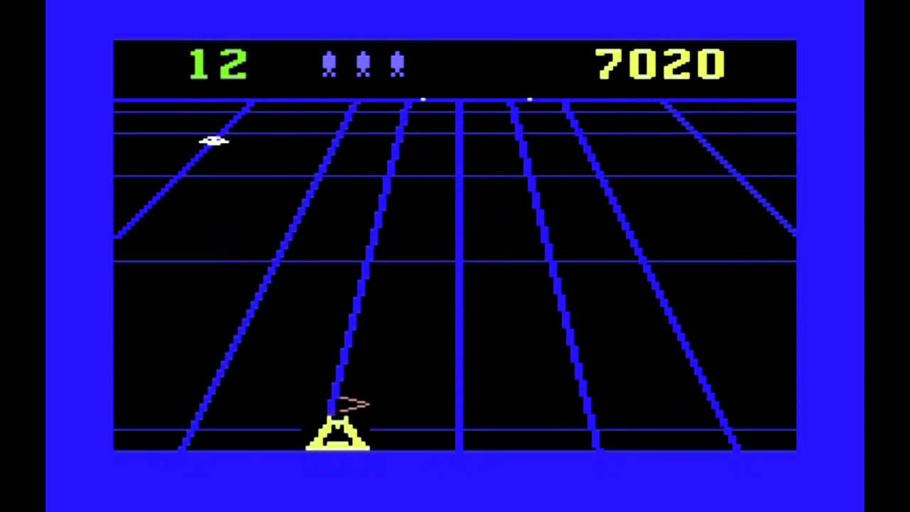
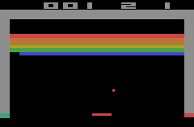
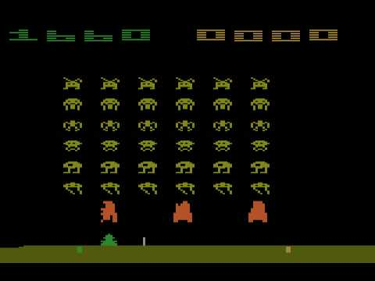
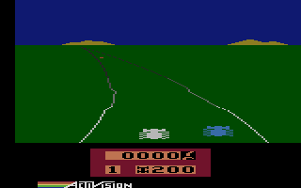
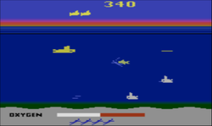
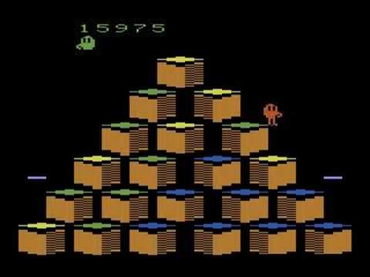
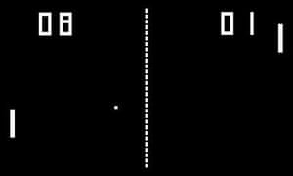
GAMES
Beam Rider
Space Invaders
Breakout
Seaquest
Enduro
Q*bert
Pong

Slide 4
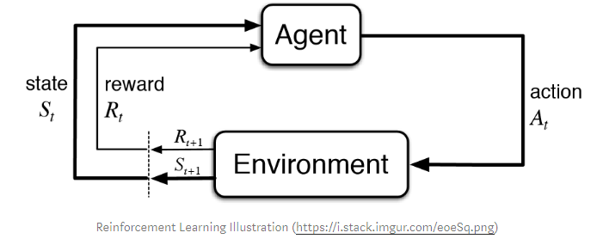
Reinforcement learning
Action (moves)
State (situation)
Reward (env. return)
Policy (cur. state → next action)
Value (long term return)
Markov Decision Process (MDP): Model-based (Environment, action & reward)
Q-Learning: Model-free (Action & reward)
Notes:
Action (A): All the possible moves
State (S): Current situation
Reward (R): environment’s return to evaluate the last action
Policy (π): The strategy to determine next action based on the current state.
Value (V): The expected long-term return with discount, as opposed to the short-term reward R.
Both try to gain the most reward from agent’s actions.
The model-based learning uses environment, action and reward to get the most reward from the action.
The model-free learning only uses its action and reward to infer the best action.

Slide 5
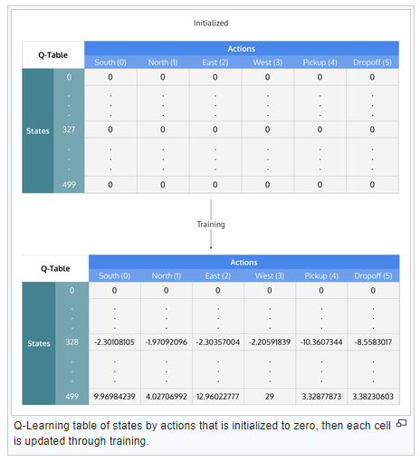

Q-learning
Q-Table: Cheat sheet for games
Action (moves)
State (situation)
Reward (env. return)
Policy (cur. state → next action)
Q-Value (action-value), Q(s,a)
Learning rate: effect of new data
Discount factor: Future reward importance
Source: https://en.wikipedia.org/wiki/Q-learning
Notes:
Q-value (Q): Q-value is similar to Value, except that it takes an extra parameter, the current action a. Qπ(s, a)
Aim is to maximize the Q value
Initial Q values are fixed (chosen by the programmer)
Learning Rate: How much new data changes the old data (0 non, 1 all)
Discount factor: Importance of the future rewards (0 short-term, 1 long-term)
Q-learning is about creating the cheat sheet Q.

Slide 6
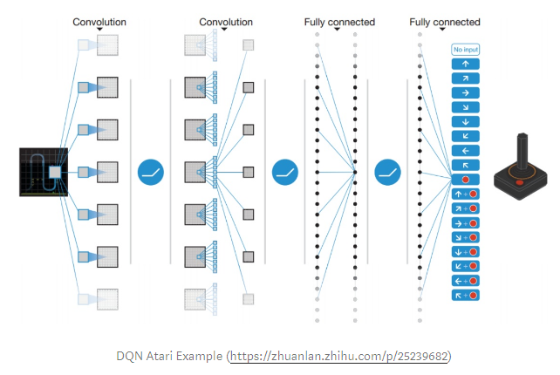
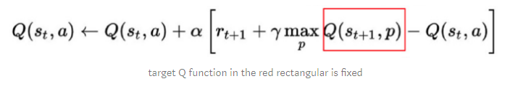
DEEP Q-networks (dqn)
Experience Replay
DNN overfits, reduces correlation between experiences (state, reward, action) in DNN
Target Network
Clipping Rewards
Every game rewards → -1, 0, 1
Skipping Frames
Use every 4 frame for input
Notes:
Experience Replay stores experiences including state transitions, rewards and actions, which are necessary data to perform Q learning, and makes mini-batches to update neural networks.
Error calculation, target function is changed frequently with DNN. Unstable target function makes training difficult. So Target Network technique fixes parameters of target function and replaces them with the latest network every thousands steps.

Slide 7
Thank you!
References
Mnih, Volodymyr, et al. "Playing atari with deep reinforcement learning." arXiv preprint arXiv:1312.5602 (2013).
Introduction to Various Reinforcement Learning Algorithms. Part I (Q-Learning, SARSA, DQN, DDPG), https://towardsdatascience.com/introduction-to-various-reinforcement-learning-algorithms-i-q-learning-sarsa-dqn-ddpg-72a5e0cb6287
Q-Learning, https://en.wikipedia.org/wiki/Q-learning
Model-free vs Model-based, https://www.quora.com/What-is-the-difference-between-model-based-and-model-free-reinforcement-learning
Deep Q-Networks (DQN), https://medium.com/@jonathan_hui/rl-dqn-deep-q-network-e207751f7ae4
Deep Reinforcement Learning, https://towardsdatascience.com/welcome-to-deep-reinforcement-learning-part-1-dqn-c3cab4d41b6b

